Slide 1
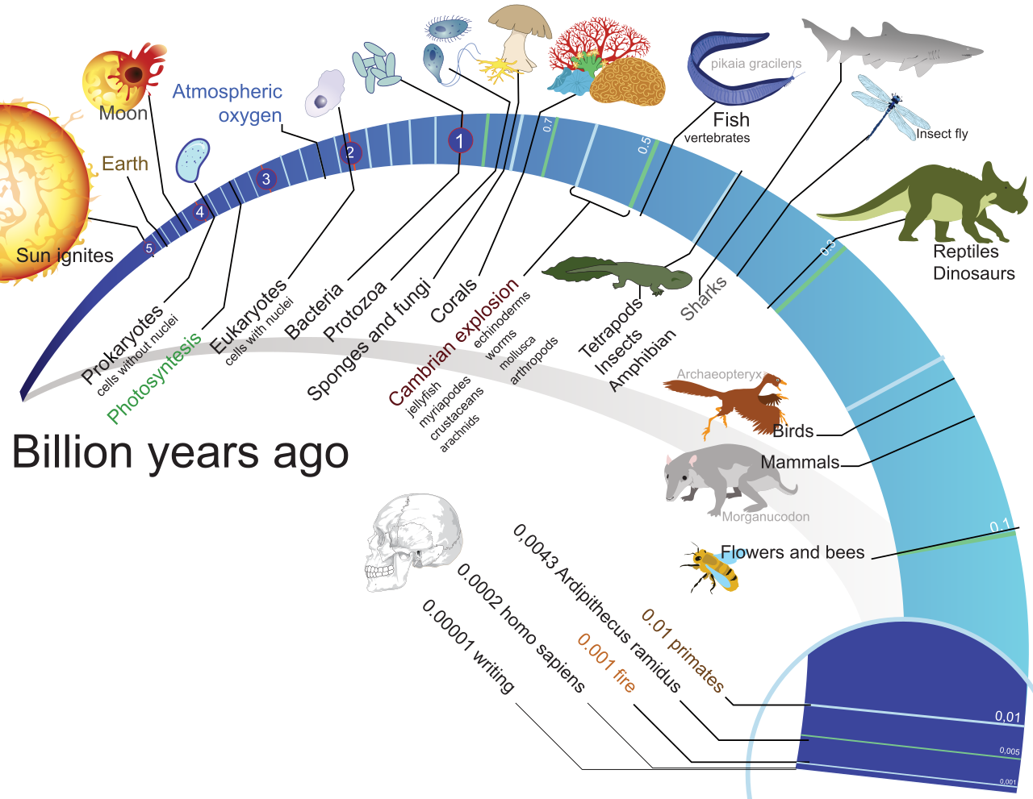
The pattern of evolution: descent with modification
Darwin’s hypothesis of descent with modification makes five key predictions
Species change through time (microevolution)
Lineages split and diverge (speciation)
Novel forms derive from earlier forms (macroevolution)
Species are not independent, but are connected by descent from common ancestors
Earth and life are old

Slide 2
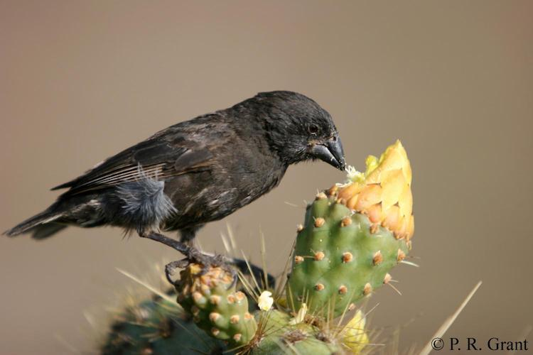
Darwin’s finches

Slide 3
Discussion questions
In relation to the R exercise
Did beak size evolve in Darwin's finches? What are the assumptions that underlie your answer?
How do you know that changes in the mean from one year to the next are meaningful?
Why is variation around the mean (standard error) high in some years and low in others?
What could potentially drive the change in beak size across time?
Additional questions
Does evolution always produce animals that are "better"? Why or why not?
Do gaps in the fossil record disprove evolution?
How do findings from other scientific disciplines influence our understanding of evolution?
Before you get started:
Make sure to introduce each other
Choose a timekeeper
Choose a reporter
Breakout groups for 20 minutes

Slide 4
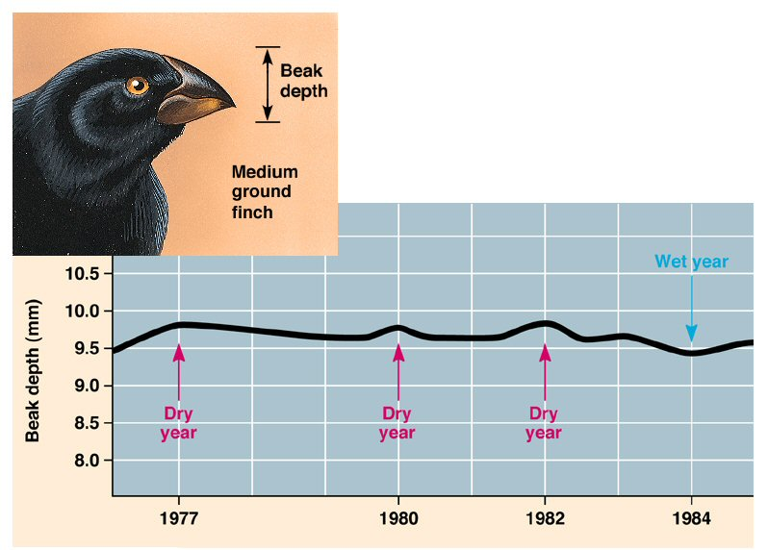
Beak size variation across time

Slide 5
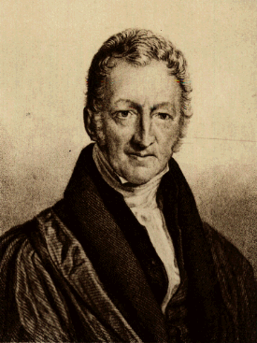
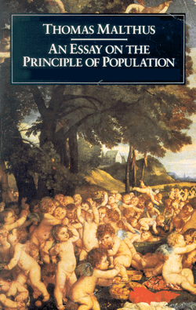
Darwin’s logic
Organisms have high reproductive potential, facilitating exponential population growth
Resources are limited
Most populations in nature are stable
Hence, there must be a fierce struggle for existence with only few progeny surviving in each generation

Slide 6
Darwin’s logic
Individuals within population exhibit enormous variability
At least some variability is heritable
Survival is not random but depends on the inherited traits (that is natural selection!)
Over generations, natural selection gives rise to gradual change of populations

